Slide 1
Introduction
01
Cybersecurity and Data Science
Cybersecurity with
Data Science
Cyber Security
&
Data Science
02
Titanic Data-sets analysis in Data Science
03
04
Implementation
Sasan Darwazi
05

Slide 2
Cyber Security and Data Science
Cyber Security: Cybersecurity protects computers, servers, mobiles, and electronic systems from unauthorized attacks.
Or, CS refers to any technologies, practices, and principles for eschewing cyberattacks or mitigating their impact.
On the other hand, Data Science is an essential part of many industries today, companies have started implementing data science techniques to grow their business and increase customer satisfaction.
Data Science is the domain of study that deals with vast volumes of data using modern tools and techniques, including essential data science skills.
It combines tools and principles including:
Mathematics, Statistics, Business, Artificial Intelligence, Computer Engineering, Programming, and Machine Learning.

Slide 3
C.S
C.S
Data Science & Cybersecurity are rapidly growing in importance to industry and government.
Cybersecurity and Data Science provides many benefits for organizations. Businesses commonly use these fields' together to predict emerging cybersecurity threats; use machine learning and analytics to protect against them.
Cybersecurity
and
Data Science
Cybersecurity data science is the use of analytics to protect systems and electric data against attacks.
Data Science, a subset of data engineering, involves creating, managing, and analyzing large amounts of disparate data sources, such as proprietary or transactional data.
D.S
D.S

Slide 4
Titanic Data-set
I will illustrate the Titanic data set, which contains information about passengers who were aboard the RMS Titanic when it sank. I walk through the data set on about 1300 passengers on the ship Titanic. So in the year 1912, the British ship RMS Titanic sank in the North Atlantic Ocean after hitting an iceberg, and a large number of passengers died.
What I am to do with this data set is to look into the disparity of survival rates of male and female passengers on the ship.
Apart from other questions, I will focus on the multivariate question types that is, “If we see a disparity in the survival rates of males and females, does that disparity differ across the three passenger classes?” This question needs more than two variables and it's called multivariate analysis in Data Science.
The mentioned questions demonstrate, what gender survived more and what gender did not, as well as the contrast of passenger classes between males and females.

Slide 5
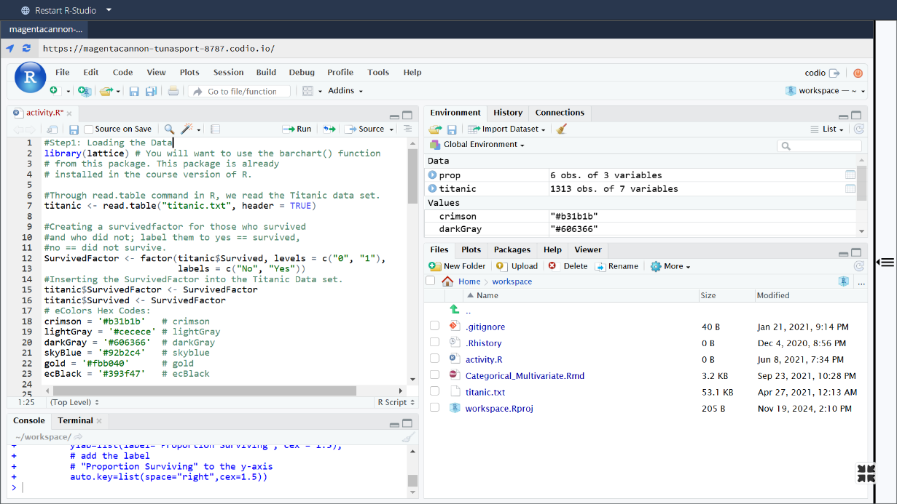
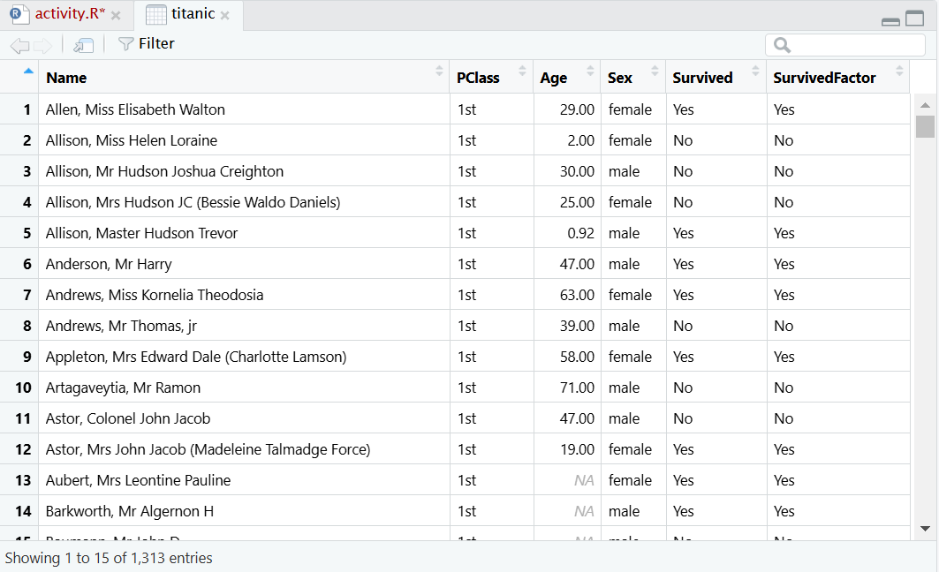
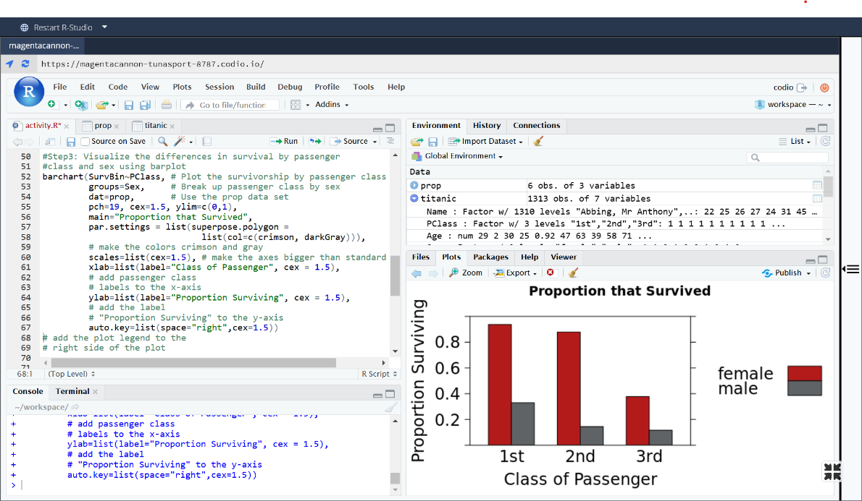
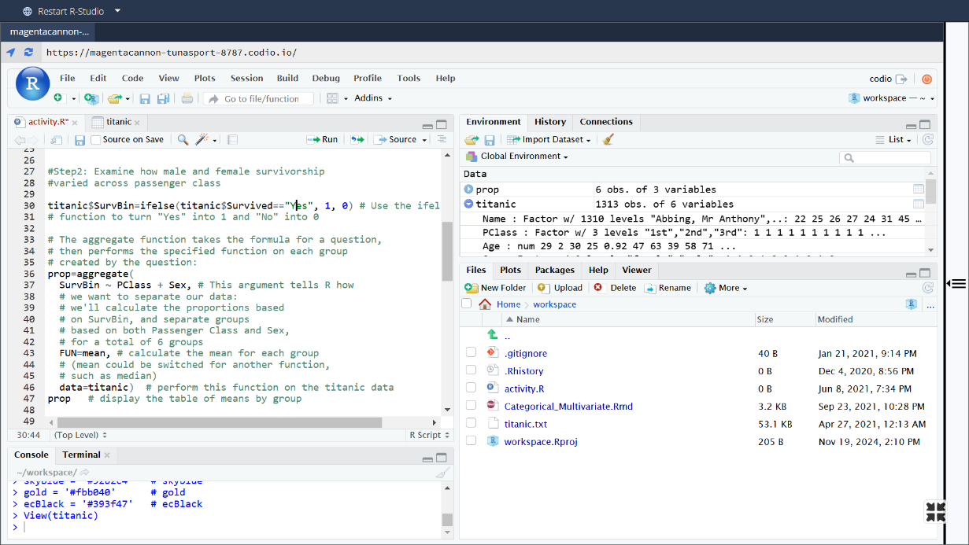
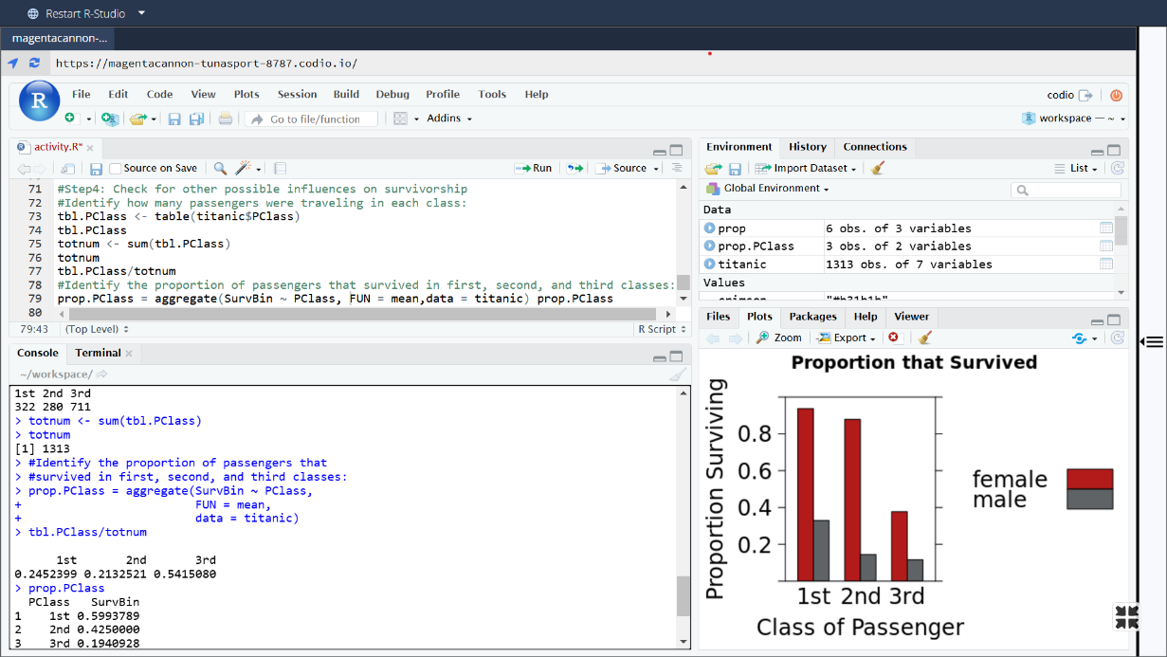
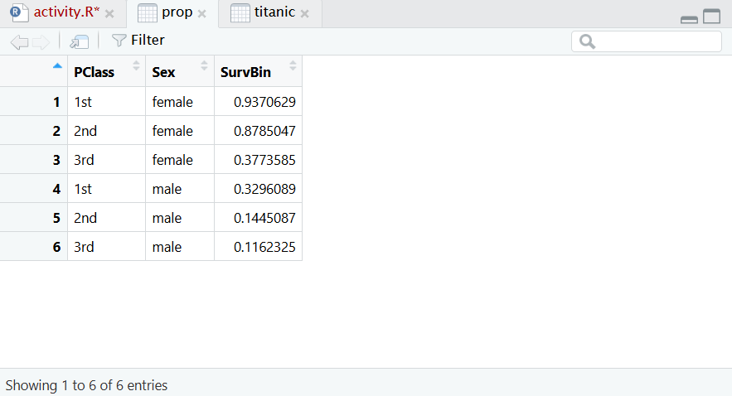
Step 1:
Load and process the data
By installing the lattice package and reading the data from the Titanic data set, we will create a SurvivedFactor for the survivors who did and did not, labeling them as Yes and No.

Slide 6
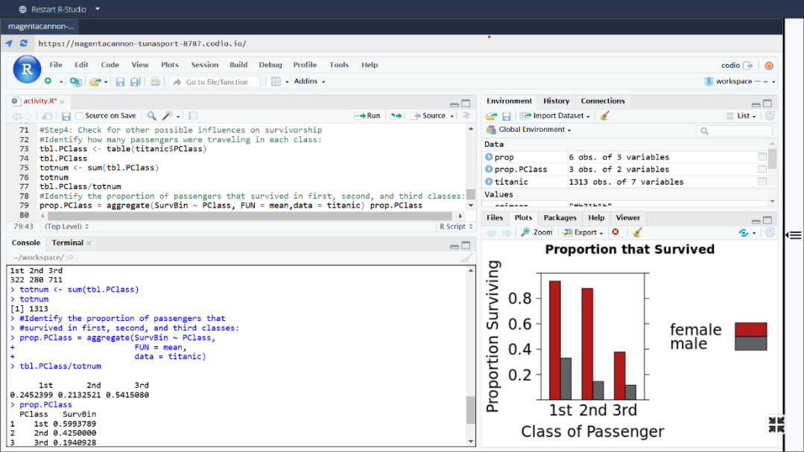
Step 2:
Examining how male and female survivorship varied across the passenger class.
To scrutinize the variation in how passenger class affected males and females, changing the survival status to 1 (yes) and 0 (no) with the if-else () command. Subsequently, we will use the aggregate() function to calculate proportions in each group.

Slide 7
Step 3:
Visualize the variation in survival by passenger class and sex using a barplot
We will use the barchart() command from the lattice package to create a barplot that demonstrates the records on all three variables of interest simultaneously.

Slide 8
Step 4:
Check for other possible influences on survivorship
Identify how many passengers were traveling in every class:
Identify the proportion of passengers that survived in first, second, and third classes:

Slide 9
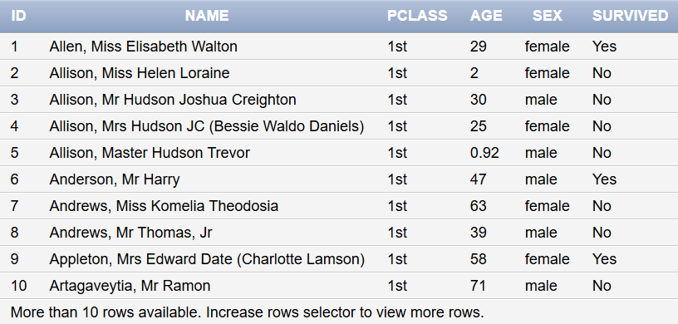
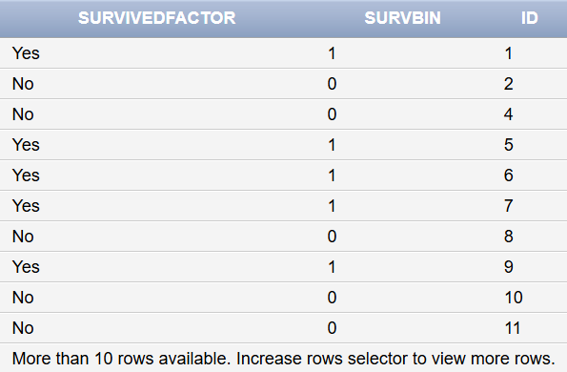




Step 5:
Sample of feeding the date into the DBMS.
By creating its database and tables, we give a hand to proliferate its database security, processes, and controls that protect the database from cyberattacks.

Slide 10
Sources:
GitHub:
https://github.com/Sasan-Darwazi/Data-Science-Essential-Course/tree/main/Day2%2C%20Cybersecurity%20and%20Data%20Science%20Project
Student in Data Science Essential Course at the Cornell University.

